Slide 1



Problem Theme :Build a Donation Matching Portal
SevaSetu
Connecting Donors with Needs, Building Bridges of Hope
Presented by Team 16
-Under guidance of Aashay Sir

Slide 2
Problem Statement brief:
Donations are made with good intent, but the process today is fragmented and inefficient. While donors are ready to contribute, beneficiaries often don’t receive what they truly need — leading to wastage, mismatch, and delays. The absence of a streamlined, transparent system makes the entire cycle unreliable.
Key Issues:
No proper platform to bridge donors and receivers.
Mismatch between donated items and real requirements.
Lack of tracking and transparency in the process.
Manual efforts leading to delays and inefficiency.
Resources not reaching the right beneficiaries on time.
2
August 20, 2024

Slide 3
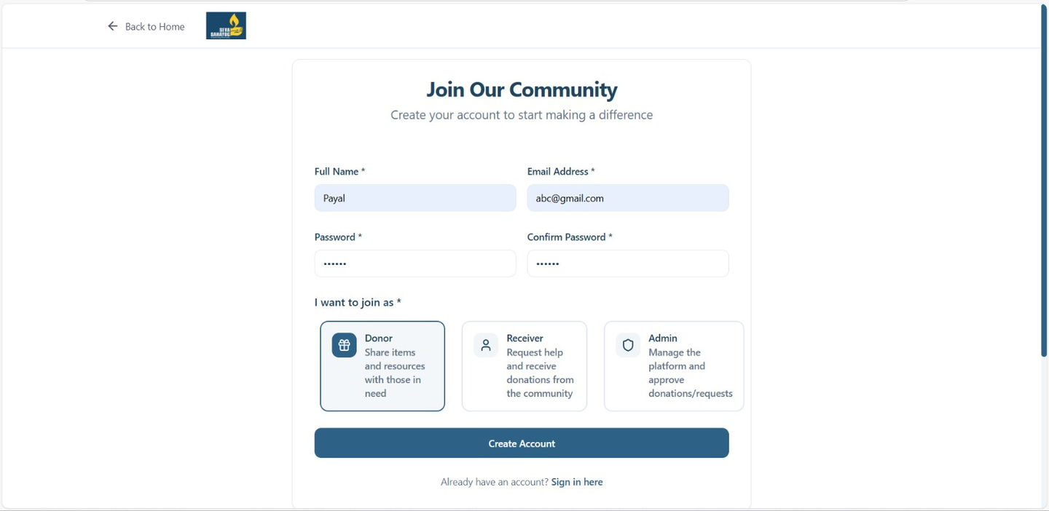
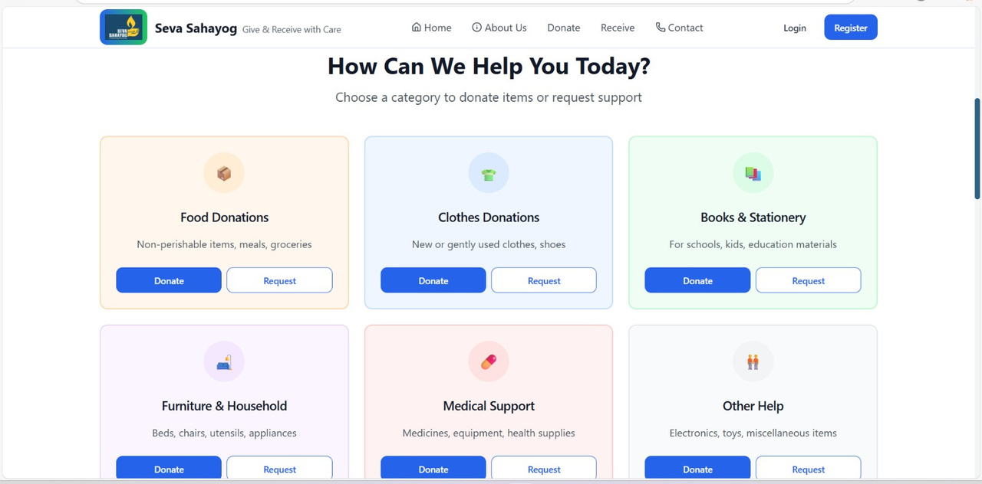
Solution Overview:
3
August 20, 2024

Slide 4
Demo/Prototype
Click here
click here
4
August 20, 2024

Slide 5
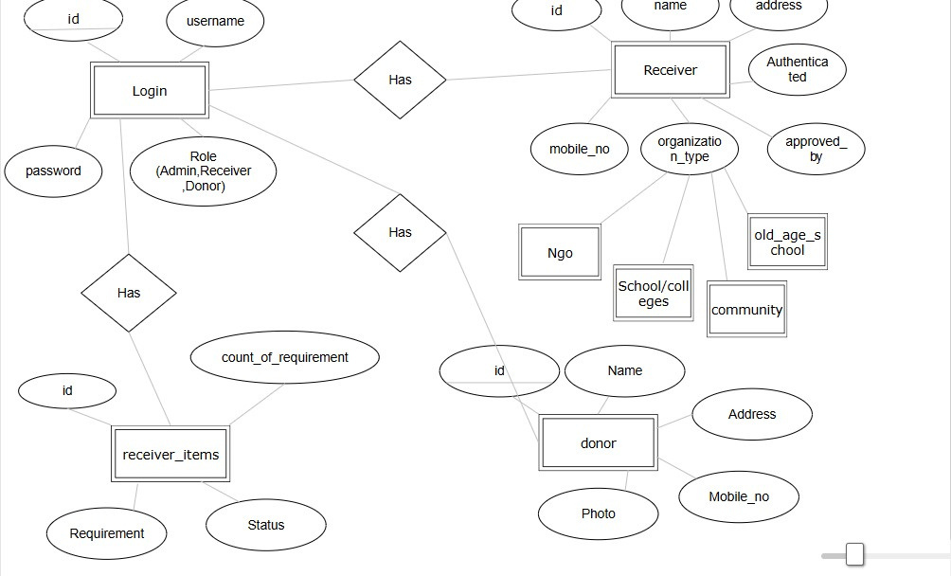
ER Diagram

Slide 6
Technology Stack
Frontend
React + TypeScript + Vite → Fast, type-safe, and responsive UI development
React Router → Smooth and seamless navigation
Backend
Node.js + Express + TypeScript → Scalable, efficient, and type-safe backend services
Database
PostgreSQL → Reliable relational database for structured storage
Designed tables for Users, Donations, Needs, and Matches to ensure efficient data handling
Other Tools & Services
Git & GitHub → Version control and collaboration
Github Repository Link :- Click here
Google Drive Link :- Click here
5
August 20, 2024

Slide 7
Impact/Future scope
Enhanced Security → Implement Two-Factor Authentication (2FA) for admin roles to prevent unauthorized access.
Smarter Matching → Extend current algorithm with Machine Learning for better accuracy, personalization, and multilingual support.
Content Safety → Use ML models to detect abusive / invalid content, ensuring platform trustworthiness.
Scalability → System can integrate with NGOs, government portals, and community platforms for wider reach.
Impact → Creates a transparent, secure, and intelligent donation ecosystem, maximizing social good and trust among stakeholders.
6
August 20, 2024

Slide 8
Q&A
7
August 20, 2024

